Slide 1

APPLE STOCK PREDICTION
Group Members
Nampelly abhinay
Samuel sundar singh gorremuchu
Vetrikumar V
Anurag Pandey
Adittya V

Slide 2
Content
Knowing dataset
Exploratory Data Analysis
Proposed Machine Learning Models
Linear Regression Model
Random forest Classifier
Garch model
Comparative Analysis of Algorithmic Results
Conclusion
Limitation
Future work

Slide 3
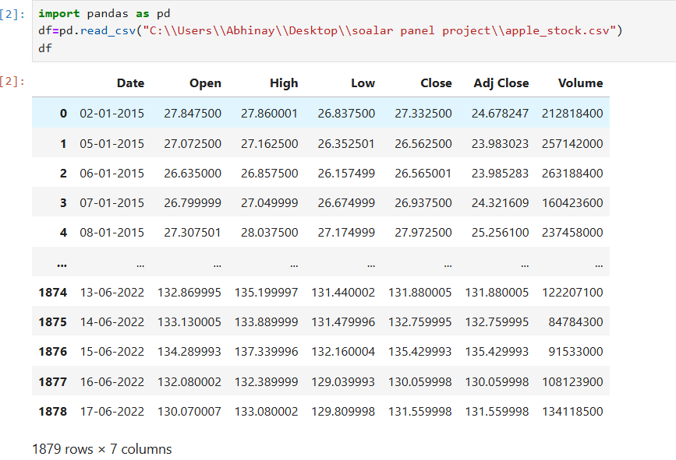
Knowing dataset
1879 rows and 7 columns
No missing value in dataset
Analyzed historical Apple stock prices from 2015 to 17/06/2022
Source Yahoo finance API.https://finance.yahoo.com/quote/AAPL/history?p=AAPL

Slide 4
Exploratory data analysis
Analyzed historical Apple stock prices from 2015 to 17/06/2022
Gained insights into long term trends, volatility, patterns
Identified events that impacted stock price
Understand relationship between Apple stock and broader market
Visualized Apple stock price over time using charts
Detected seasonal patterns or recurring trends
Derived key insights to inform trading, modeling, and predictions

Slide 5
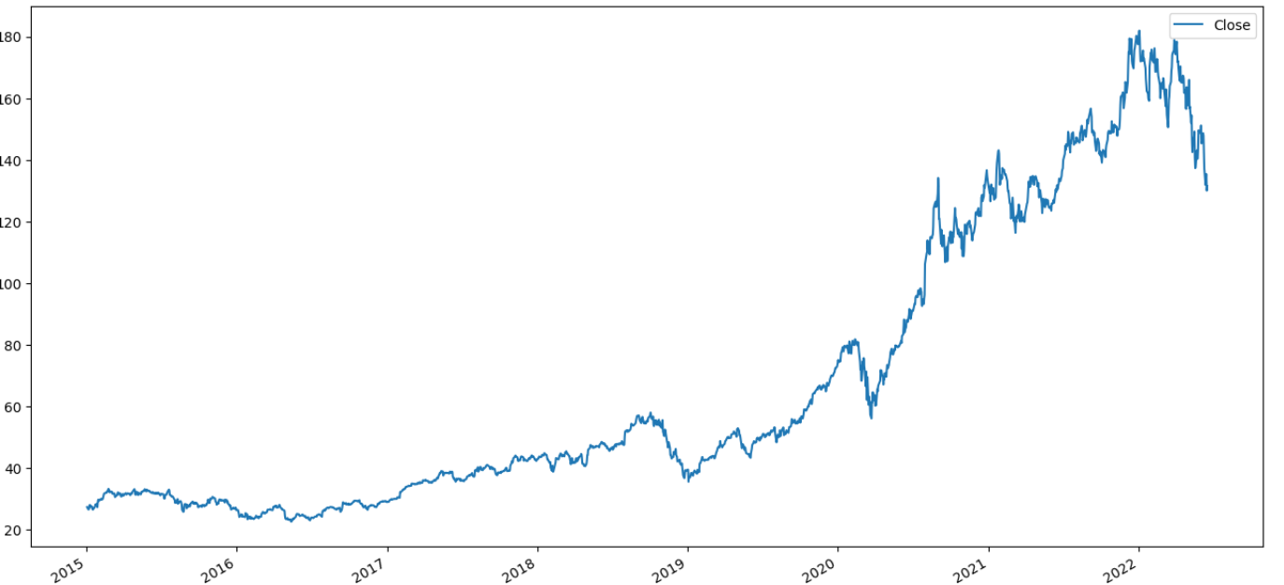
Apple stock Prices over the time

Slide 6
PROPOSED MACHINE LEARNING MODELS
Selection of Linear Regression, Random forest classifier and garch model
We used the Linear Regression to split the data into test and training sets and then trained the model with the training set to predict the stock's future price.
For Random Forest classifier we have created a binary target variable that tells whether tomorrow’s stock price will be greater than or less than today's closing price and this is the hypothesis of our second model.
For Garch model,we are forecasted volatility varience for the next 30 periods

Slide 7
Linear Regression algorithm
Linear regression is a simple and easy-to-understand algorithm. It's based on the assumption that there is a linear relationship between the input features and the target variable. In the context of stock prediction, simplicity can be an advantage, especially when dealing with a small to moderate amount of data.
Below are metrics of Linear regression model
Root Mean Squared Error (RMSE): The RMSE is a measure of the average magnitude of the errors between predicted and actual values. In your case, an RMSE of approximately 2.711510159197194e-10 indicates that the model's predictions are very far to the actual values.
Mean Absolute Error (MAE): The MAE is another measure of the average magnitude of errors. A MAE of approximately 1.983620454654285e-10 reinforces the idea that the model's predictions are not too accurate.

Slide 8
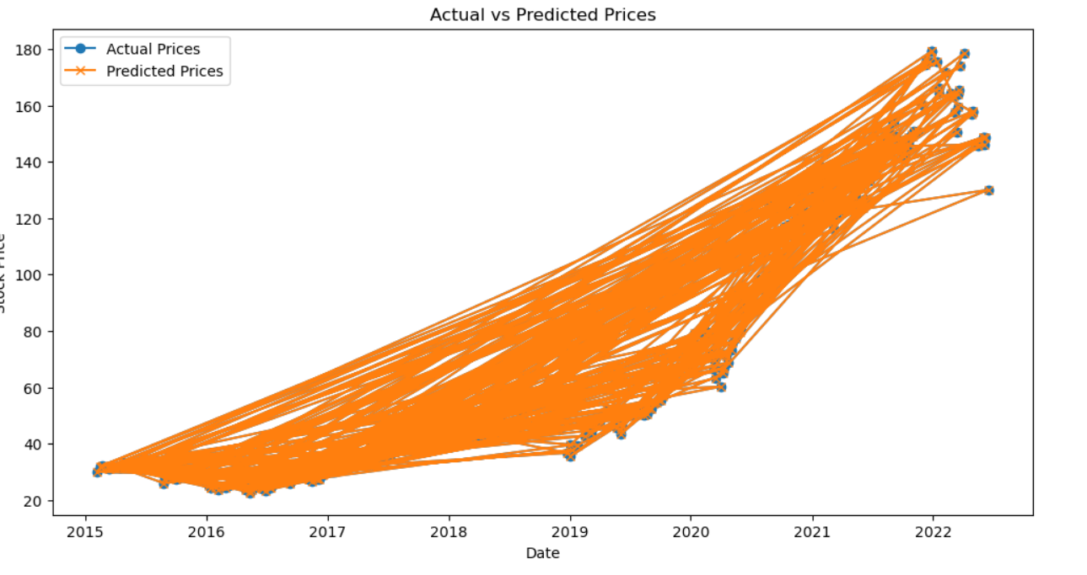
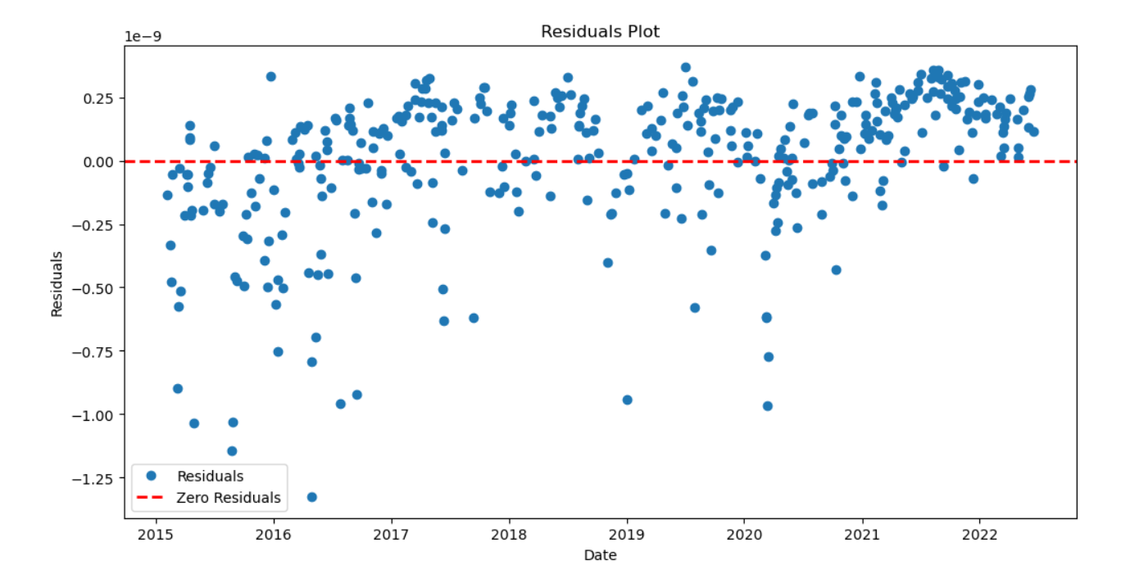

Slide 9
Random forest Classifier Algorithm
Random Forest provides a measure of feature importance, aiding in identifying key factors influencing stock movements.
In the dataset we created new column called "tomorrow". The values of this column is the values of the "close" column. But with the shift of -1.
After this we have created another column called "target" column. This is a binary valued column with values 0 and 1.
0 indicates "tomorrow" column < "close" column
1 indicates "tomorrow" column > "close" column
Our aim is to predict target column.

Slide 10
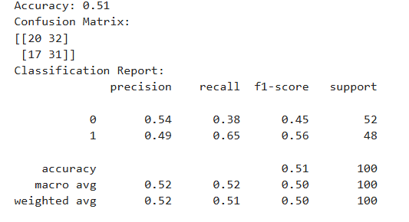
continued
The model's accuracy is around 51%, which indicates that the model is making correct predictions for slightly more than half of the instances.
There appears to be an imbalance in the dataset, as indicated by the differences in precision, recall, and F1-score between the two classes. Class 1 (perhaps indicating a particular stock movement) has lower precision compared to Class 0.
The precision for Class 0 is higher, suggesting that when the model predicts an increase in stock prices, it is correct more often. However, the recall is low, indicating that the model misses a significant number of instances where stock prices actually increase.

Slide 11
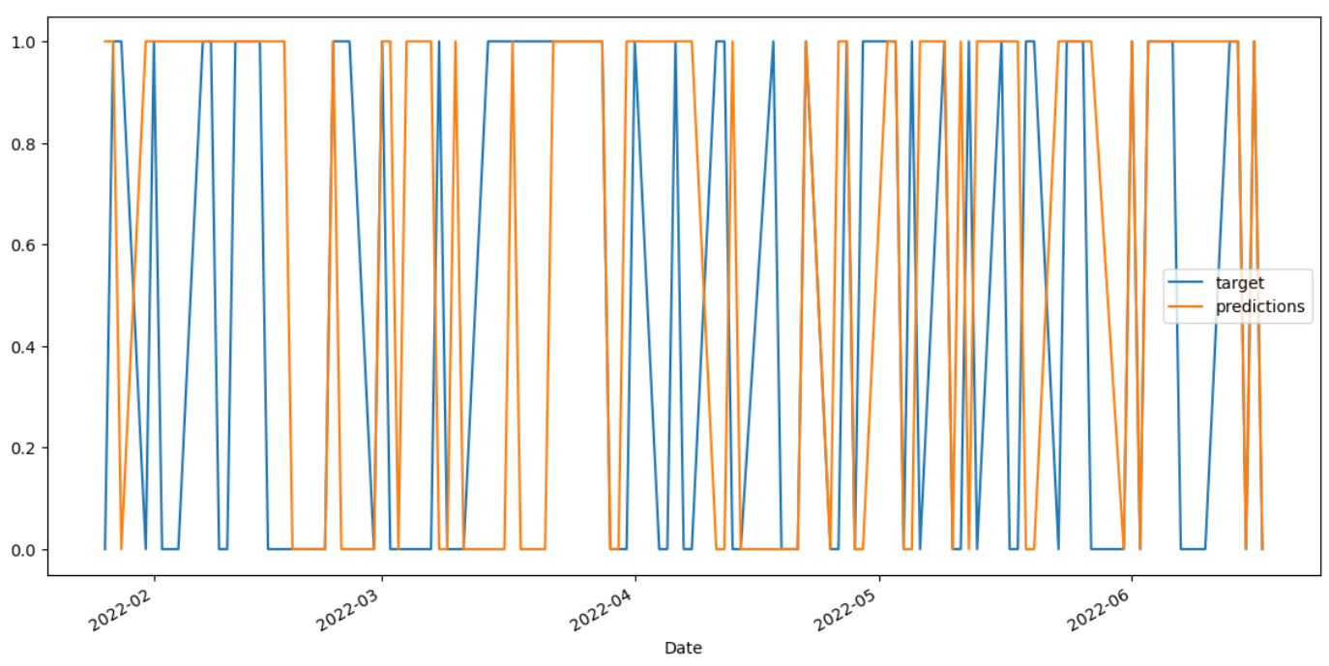

Slide 12
garch model
Volatility clustering: the GARCH model effectively capturing volatility clustering ,which is a key feature of financial time series data
This means the periods of high volatility tends to be followed by other periods of high volatility ,and vice versa.
Model parameters : the model summary provides information about the estimated parameters of the GARCH model.
These parameters (eg: ARCH and GARCH coefficients) indicates the influence of past squared returns on current volatility.
Model fit : the model performance can be acsessed using various statistical measures such as long-likelihood and AIC/BIC.
Volatility forecast : the volatility forecast generated by the model can be used to understand the expected leval of future volatility.

Slide 13
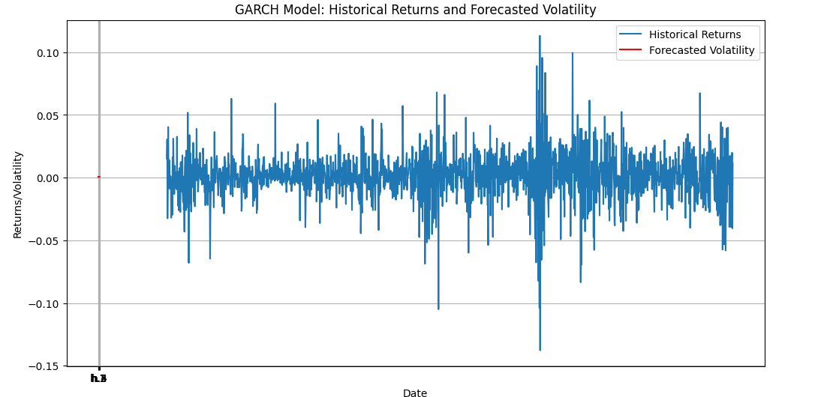
Hestorical returns and forecasted volatility

Slide 14
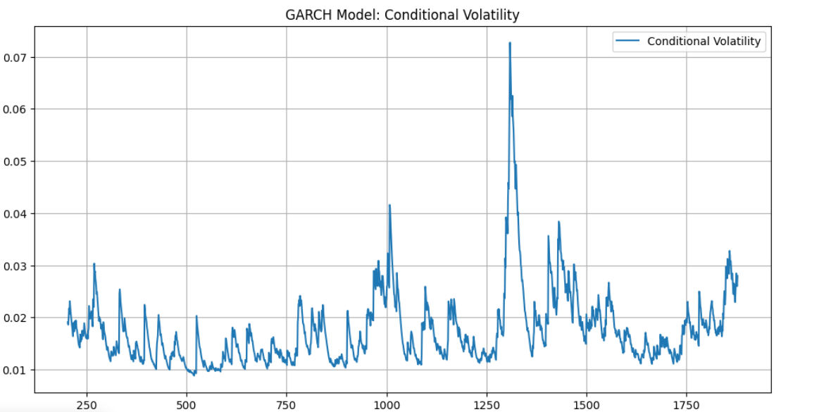
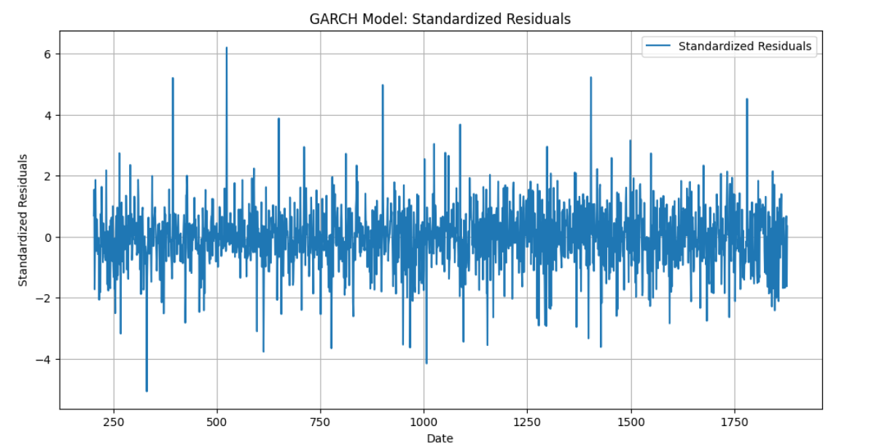

Slide 15
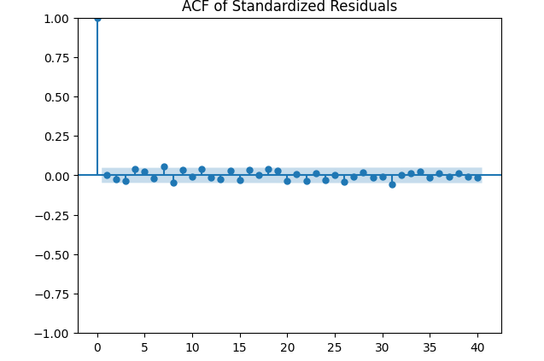
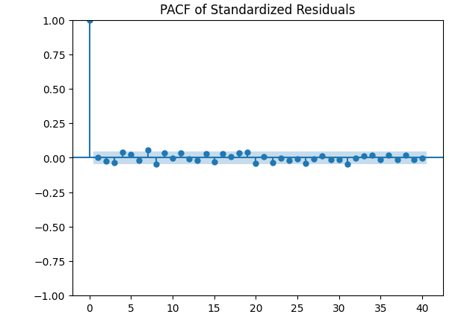
ACF and PACF of standardized residuals

Slide 16
Comparative Analysis of Algorithmic Results
Linear Regression:
Strengths: High R-squared (1.0) indicates a good fit. However, the RMSE and MAE values suggest a substantial error in predicting stock prices.
Concerns: The high error metrics (RMSE and MAE) might indicate limitations in capturing the underlying patterns in the data.
Random Forest Classifier:
Strengths: While the accuracy is 0.51, indicating performance slightly better than random chance, the precision for class 0 (stock price increase) is relatively high at 0.54.
Concerns: The model appears to struggle with recall for class 0, indicating a high number of false negatives.
Garch:
Strengths: captures volatility clustering : Garch models are effective at capturing the phenomenon of volatility clustering,where periods of high volatility tend to be followed by other periods of high volatility ,and vice versa this is the crusial ascept of fainacial time series data.
provides volatility forecasts : the model generates forecasts of future volatility which can be valuble for risk management ,portfolio optimization , and trading strategies.
relatively simple to implement : compare to more complex models ,garch models are relatively straightforward to implement and understand
Concerns: limited ability to capture non-linear effects : garch models are primarly based on linear realtionships between varibles .they may not adequately capture more complex non-linear dynamics that might be present in fainacial markets.
sensitivity to model parameters : the performance of GARCH model can be sensitive to the choice of model parameters (p and q).selecting appropriate values for these parameters is crusial for accurate forecasting.

Slide 17
Conclusion
Linear regression model is not accurate, and it needs extensive hyper tuning of parameters
Random forest classifier is comparatively good performer than Linear regression model.
Garch is giving more precise results if trained well.

Slide 18
limitatons
The model has certain limtations ,such as its sensitivity to model parameters and its assumption of normality.
It may not be able to capture non-linear effects or complex patterns in the data.

Slide 19
Future work
Model refinement and optimization
Advanced forcasting techniques
Risk management and portfolio optimization applications
Trading statagies
Real time implimantation
Model interpretability and explainability
Backtesting and stress testing
Continous monitoring and model updating

Slide 20
Thank You

